Slide 1
PARIS SUMMIT OUTCOMES

Slide 2
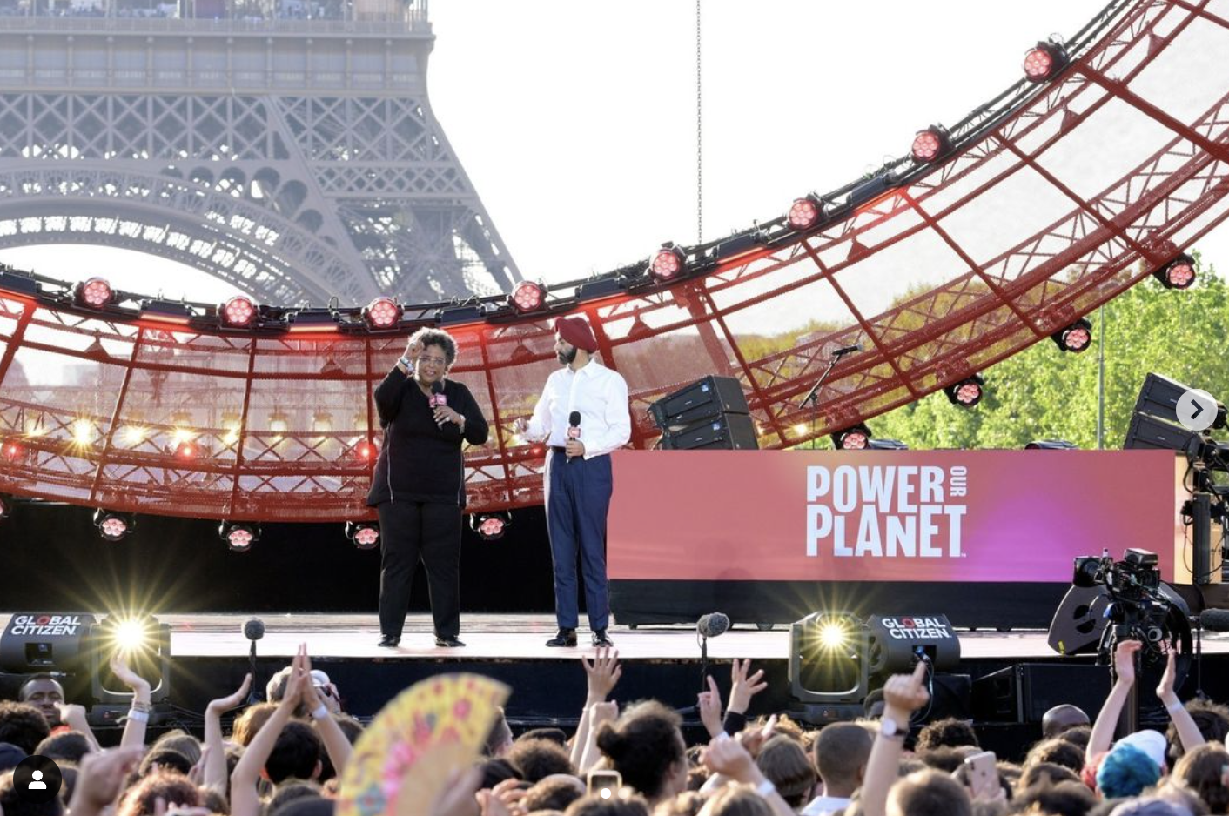
BUT ALSO:
Bridgetown support
Climate/ development narrative
Strong show of leadership from Global South
Follow-up mechanism and roadmap with champions
Disengagement from G7
Window dressing of existing promises

