Slide 2
Briefing Agenda
Agenda & Politics: agenda, ambition, red flags
Ways of Working: Sherpa Office, Ministerials
Civil Society Engagement
Issues: Deep dive on climate
Question & Answers and Briefing Participant’s Positions & Priorities.

Slide 3
G7 Agenda
Africa – partnership, economic, emigration
AI – AI and labour
Climate & Energy
Food Security
Migration
Gender
Nuclear Proliferation
Ukraine
Gaza
Economics & Finance
www.g7italy.it

Slide 4
Priorities
Africa – Italy wants a renewed engagement Africa – more partnership than predator. Will invite a number of African Heads of State. Meloni’s Sherpa called the 2024 G7 the ‘Mediterranean Summit’
AI – Meloni recently introduced this as a priority – will have an event on this in the lead up to the Summit – focus is on AI and labour
Migration – how to address migration. Linked to the focus on Africa. Very important domestic issue for Meloni.
Climate – climate finance, energy transition especially in Global South

Slide 5
Ministerials 2024
Industry, Tech & Digital (13-15 Mar)
Transport (11-13 Apr)
Foreign Affairs (17-19 Apr)
Climate, Energy & Environment (28-30 Apr)
Justice (9-10 May)
Finance (23-25 May)
Education (27-29 Jun)
Science & Technology (9-11 Jul)
Trade (16-27 Jul)
Urban Development (24-26 Jul)
Culture (19-21 Sep)
Labour & Employment (11-13 Sep)
Agriculture (26-28 Sep)
International Development (Oct tbd
Interior (2-4 October)
Gender Equality & Women’s Empowerment (4-6 Oct)
Health (9-10 Oct)
Inclusion & Disability (14-16 Oct)
Tourism (November TBC)
Foreign Affairs (late 2024)

Slide 7
G7 Sherpa Office
Amb. Luca Ferrari – G7 Sherpa & G7 Diplomatic Advisor to the Prime Minister
Fausto Panchianco – G7 Head of Office
Francesco Rampa (Food & Nutrition Expert)
Claudio Cali (Health Expert)
Fabrizio Saggio –Diplomatic Advisor to PM
Agostino Inguscio & Duccio Maria Tenti (Climate Energy & Env Experts)
11 other experts

Slide 8
Key Moments – January
Issue Papers:
Italy will produce issue papers on each of the areas for circulation to the other G7 governments (not public)
PM Meloni speech at Davos
will formally lay out the agenda
1st Sherpa meeting
will take place in 24th January normally.
The G20 publishes the dates and locations of the Sherpa meetings – the G7 does not

Slide 9
G7 Official Engagement Groups
Business 7
Civil 7
Labour 7
Science 7
Think 7
Urban 7
Women’s 7
Youth 7

Slide 10
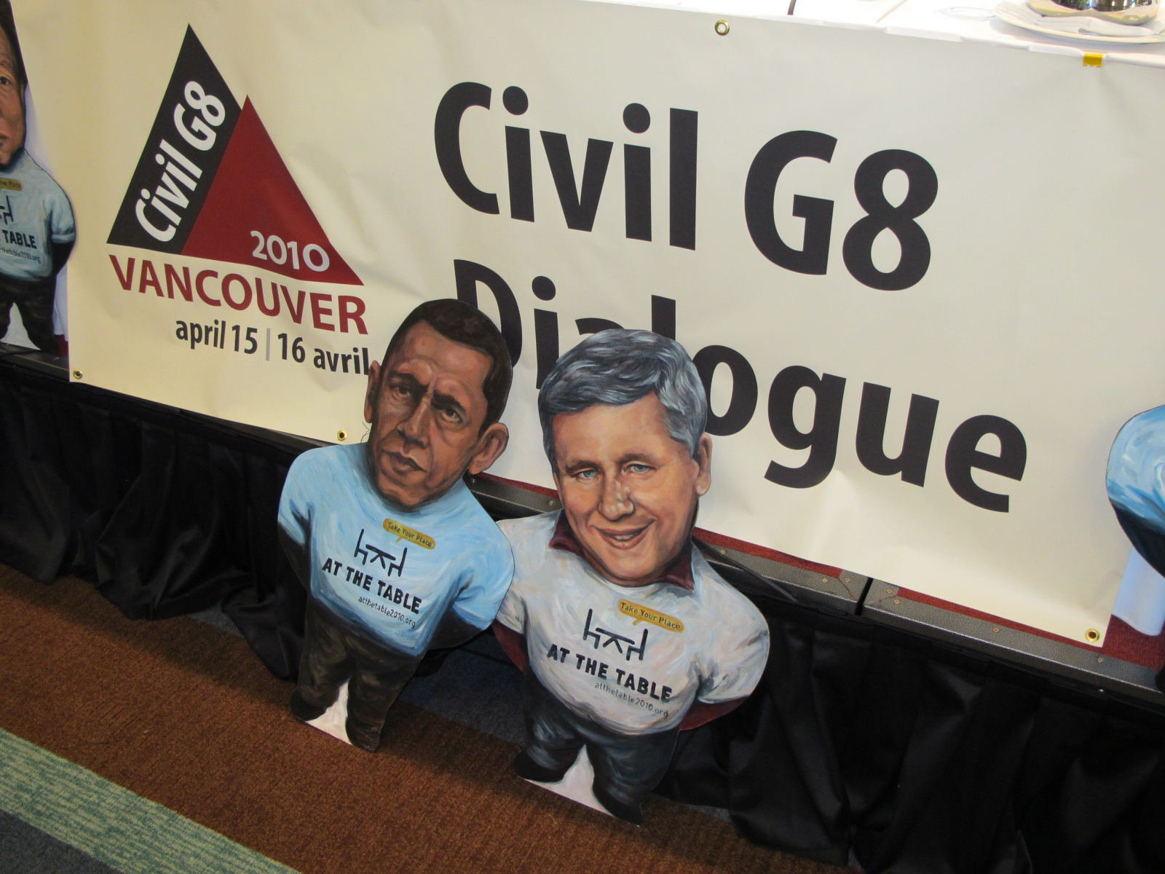
Civil 7

Slide 11
C7 2005 - 2012

Slide 12
C7 2013 - 2023

Slide 13
Questions & followed by discussion

